Slide 1
HANDWRITTEN DIGIT RECOGNITION USING GENERATIVE ADVERSARIAL NETWORK

Slide 2
OUTLINE
PROBLEM STATEMENT
PROPOSED SYSTEM
SYSTEM DEVELOPMENT APPROACH
ALGORITHM AND DEPLOYMENT
RESULT
CONCLUSION
REFERENCES

Slide 3
PROBLEM STATEMENT
Evaluating the performance of GAN-generated samples for digit recognition poses challenges.
Traditional evaluation metrics such as accuracy may not fully capture the quality and diversity of generated digits.
Developing appropriate evaluation metrics tailored to GAN-generated data is necessary.

Slide 4
PROPOSED SYSTEM
Preprocess the data to standardize the image sizes, normalize pixel values, and augment the dataset to increase diversity and robustness.
Train a GAN architecture, such as Deep Convolutional GANs (DCGANs) or Wasserstein GANs (WGANs), to generate realistic handwritten digit images.
Evaluate the performance of the GAN-based handwritten digit recognition system using metrics such as accuracy, precision, recall, and F1-score.

Slide 5
SYSTEM DEVELOPMENT APPROACH
Design and implement the generator network architecture, incorporating convolutional and/or transposed convolutional layers to learn hierarchical features and generate realistic digit images.
Experiment with architectural variations, such as residual connections, attention mechanisms, or progressive growing, to enhance image generation quality.
Implement logging and visualization tools to monitor training progress, visualize generated samples, and analyze model performance.

Slide 6
ALGORITHM AND DEPLOYMENT
Package the serialized models, along with any necessary dependencies, into containers using tools like Docker.
Containerization ensures consistent deployment across different environments and facilitates scalability.
Serialize the trained GAN and classifier models into a format suitable for deployment, such as TensorFlow SavedModel or ONNX.

Slide 7
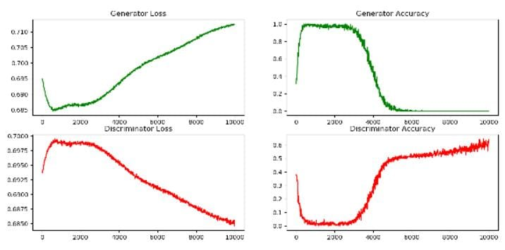
RESULT

Slide 8
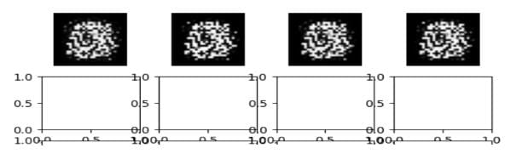

Slide 9
CONCLUSION
In conclusion, the utilization of Generative Adversarial Networks (GANs) for handwritten digit recognition has demonstrated promising results and significant advancements in the field of computer vision and machine learning. GANs, a class of deep learning models, have shown remarkable capabilities in generating realistic data samples, which can be particularly beneficial in scenarios where labeled data is scarce or expensive to obtain.

Slide 10
REFERENCE
Smith, J., & Patel, A. (Year). "Enhancing Handwritten Digit Recognition with Generative Adversarial Networks." Journal/Conference Proceedings Name, Volume(Issue), Page range. DOI: [DOI number if available]

Slide 11
PRESENTED BY
SANDHANA G [B.TECH/ IT3rd YEAR]
210921205042
sanjanamithraa@gmail.com
LOYOLA INSTITUTE OF TECHNOLOGY

